Slide 1
PROTEIN STABILTY

Slide 2
Protein Stability: The ground reality
Native proteins are only marginally stable entities
The structure of a protein is the result of a delicate balance between powerful countervailing forces

Slide 3
Protein Stability: Comparing free energies
ΔG (denaturation) 0.4 kJ mol⁻¹ per
amino acid residue
=> 40 kJ mol⁻¹ for a 100 residue protein.
Compare : ΔG (breaking H-bond ) 20 kJ mol⁻¹.

Slide 4

Protein Stability : The different forces
Electrostatic forces
    Ion pairs or salt brides
    Dipole-dipole interactions
    London dispersion forces
Hydrogen bonding forces
Hydrophobic forces
Disulphide bonds

Slide 5

Protein Stability: Ionic interactions
Example : Side chain of a K with that of a D residue
  Charge-centres separated by ~ 4A
  Dielectric constant of medium ~ 4
  ⇒ ΔG -86 kJ mol⁻¹
  Scales @ r⁻¹ with distance
Facts: 75% of charged residues occur in pairs
    Charged residues are rarely buried.
    Exposed ion pairs are poorly conserved in homologous proteins
    Scales @ r⁻¹ with distance ⇒ long range effect

Slide 6

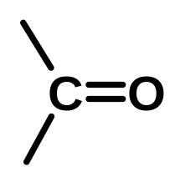
Protein Stability : Dipole-dipole interaction
Example : Two aligned carbonyl groups
        Each dipole = 4.2x10⁻³⁰ cm (1.3D)
        Separation 5
        Dielectric constant of medium ~ 4
        ⇒ΔG - 9.3 kJ mol⁻¹
        Scales @ r⁻⁻³ with distance ⇒ short range effect
δ+ δ-
δ+ δ-
A

Slide 7
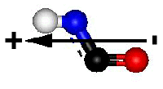
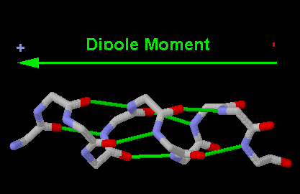

Protein Stability : Dipole-dipole interaction
FACTS: Dipole-dipole interaction is weak but may be associative as in an α-helix
  All C=O points towards C-terminal
  and α- helices have high net dipole moment
  Such dipole-dipole interactions
  are significant in the low dielectric constant core
  Influences docking
Notes:
jlohbpw'i'rgtpqav'inp;eh

Slide 8
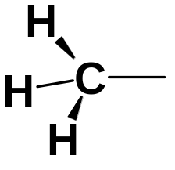
Protein Stability : Other electrostatic interactions
Dipole – induced dipole interactions
        Example
        Weak attraction sealing @ r⁻⁶ with distance.
London dispersion forces
        Example
        very weak attraction scaling @ r⁻⁶ with distance.
        Very short range effect
δ+
δ+ δ− -
δ -
δ+
δ+
δ+
δ+
δ -
δ -
δ+
δ+
δ+
δ+

Slide 9
Protein Stability : Other electrostatic interactions (contd.)
Facts :
      These forces are very weak and operative over very short ranges.
      Most effective on Van der Waals contact.
      Multiple interactions are associative and directs steric fits and docking
      Influences conformations

Slide 10
Protein Stability : Hydrogen bonding forces
Hydrogen bonding is different from electrostatic forces because of directionality
May be described as D-H----A
Association energy –12 to –30 kJmol⁻¹
Example
N H O
C
Usually N-H bond is linear with lone pair of oxygen
:
:
-
:
-
-
-
-

Slide 11
Protein Stability : Hydrogen bonding forces
Distortion in directionality often observed
Example
      Along C=O bond axis instead of oxygen lone pair orbital as in α-helix or antiparallel
      β-sheet.
      Grossly distorted as in parallel β sheet.

Slide 12
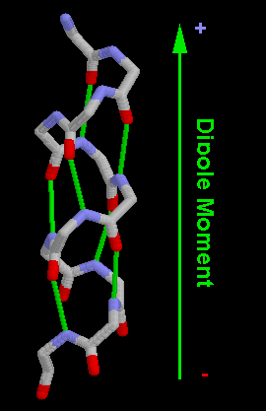
Along C=O bond
axis instead of
oxygen lone pair
orbital

Slide 13
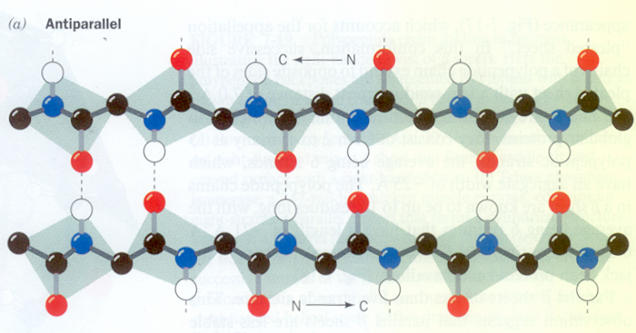
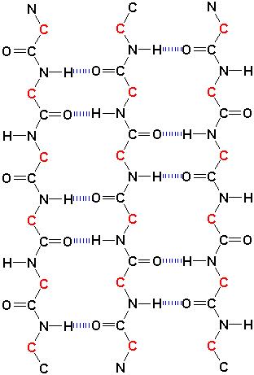
Along C=O bond
axis instead of
oxygen lone pair
orbital

Slide 14
Protein Stability : A short quiz!
State whether true or false
        Ion pairs contribute little stability towards a protein’s native structure.
        Dipole-dipole interactions significantly stabilize protein structures
        Internal hydrogen bonding significantly stabilize the native protein structure compared to its unfolded state.

Slide 15
Protein Stability : Answer to quiz.
Ion pairs …………………………….True!
Dipole-dipole……………True!
Internal hydrogen bonding …………..False!
compared to its unfolded state

Slide 16
Protein Stability : So what is the new factor?
Water – The biological solvent is highly polar
      Stabilizing forces become significant only when interaction with water DOES NOT INTERVENE
      ( guess when and where in a protein situation can that happen?)
      Denatured protein provides
        Maximum solvation of charged residues.
        Maximum hydrogen bonding
  Conclusion Intermolecular stabilizing forces are important for deciding the protein folding and preference of one folded configuration/conformation over another.

Slide 17
Protein Stability : Ionic interactions
RECAP
Ionic interactions are strong but do not greatly stabilize proteins.
Charged residues influence protein folding by tending to get exposed.
Charged residues are rarely instrumental in bringing together core regions, since they (CHARGED RESIDUES)
are mostly at the surface of the folded proteins.

Slide 18
Protein Stability : Dipole-dipole interactions
RECAP
Dipole-dipole interactions are weak but significantly stabilize protein structures.
They become more significant in the low dielectric constant core regions
These interactions being associative, have a cumulative effect on structure stabilization.

Slide 19
Protein Stability : Hydrogen bonding
RECAP
Internal hydrogen bonding cannot significantly stabilize (may even slightly destabilize !!!)
the native structure relative to the unfolded structure.
Internal hydrogen bonding provides a structural basis for native folding pattern. This
is also true with dipole-dipole interactions.

Slide 20
Protein Stability : Summary of electrostatic potentials
TYPE OF INTERACTION | ORDER OF MAGNITUDE | RANGE OF INTERACTION
CHARGE-CHARGE | -187 kJ mol⁻¹ | 1/r
CHARGE-DIPOLE | INTERMEDIATE TO CHARGE-CHARGE AND DIPOLE-DIPOLE | 1/r²
HYDROGENBOND | -12 to -30 kJ mol⁻¹ | 1/r²
DIPOLE-DIPOLE | -93 kJ mol⁻¹ | 1/r³
CHARGE-NONPOLAR |  | 1/r⁴
DIPOLE-NONPOLAR |  | 1/r⁶
NONPOLAR-NONPOLAR | -0.3 kJ mol⁻¹ | 1/r⁶
LONGEST RANGE
OF EFFECT-
EVEN UPTO
15
A
CAN GENERATE
CONCENTRATION OF CHARGES
ON PROTEIN SURFACE AND
GENERATE POWERFUL
ELECTROSTATIC STEERING
EFFECT ON LIGANDS AND
OTHER PROTEINS AT
LONGER RANGES .
.

Slide 21
Protein Stability : The Hydrophobic effect
RECAP
Hydrophobic effect causes
        Nonpolar substances to minimize contact with water.
        Amphipathic substances (such as soaps) to form micelles
        In proteins, hydrophobic effect causes non polar group to fold into the core.
        The process is endothermic for aliphatic and athermic for aromatic groups.
        Large positive ΔS makes ΔG for the process negative ⇒ the process is entropy driven.

Slide 22
Protein Stability : The Hydropathy Scale
Positive Hydropathy
Negative Hydropathy
Side chain
Hydropathy
Side chain
Hydropathy
Ile
Val
Leu
Phe
Cys
Met
Ala
4.5
4.2
3.8
2.8
2.5
1.9
1.8
Arg
Lys
Asn
Asp
Gln
Glu
His
Pro
Tyr
Trp
Ser
Thr
Gly
-4.5
-3.9
-3.5
-3.5
-3.5
-3.5
-3.2
-1.6
-1.3
-0.9
-0.8
-0.7
-0.4

Slide 23
Protein Stability : Disulphide bonds
RECAP
S-H bonds in two cysteine residues is converted to a cysteine with a S-S bond.
Cytoplasm has a reducing environment and has few proteins with S-S bonds.
The environment in the EPR is oxidizing. Secreted proteins develop disulphide bonds in the epr.
Disulphide bonds stabilize tertiary structure.

